Slide 1

PROJECT MANAGER BRIEFING
Lower-Basement
SIMOPS
GROUND LEVEL
Emergency rescue, live permit control and concrete-strength evidence for heavy lifting and structural concreting.
LIFT / FALL ZONE
WORKFACE COMMAND · RESCUE ROUTE · LIFT INTERFACE · NDT COMPLIANCE
EVACUATION ROUTE
CONGESTED INTERNAL WORKFACES INSIDE ACTIVE RETAINED EXCAVATIONS
01 / 12

Slide 2

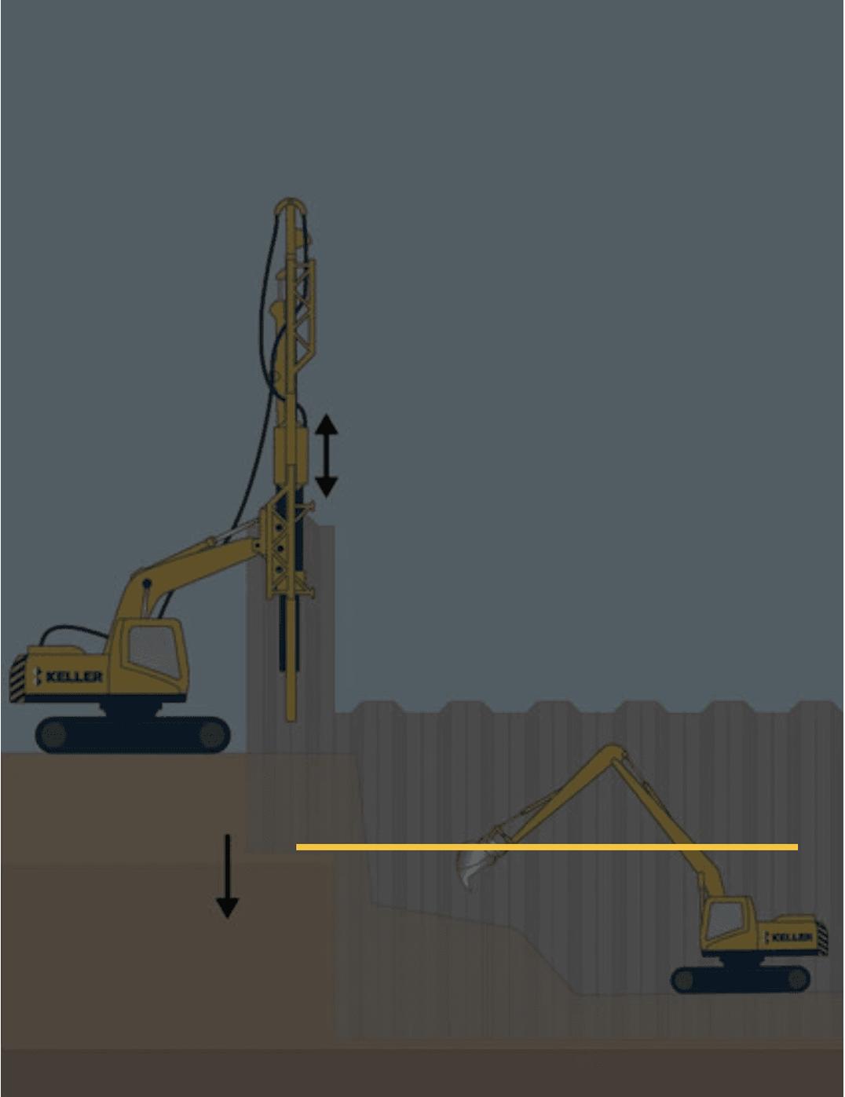
01 / MANAGEMENT POSITION
One workface.
One safety case.
Heavy lifts, concrete placement, formwork, water control, temporary support and emergency access must be accepted as one integrated decision.
01
LIFT CONTROL
Load, route, crane position, exclusion and emergency contingency.
02
CONCRETE CONTROL
Pump, hose, formwork capacity, pour sequence and protected egress.
03
EXCAVATION CONTROL
Shoring, surcharge, dewatering, monitoring and structural stability.
04
PEOPLE CONTROL
Separated work zones, planned routes, communication and emergency command.
05
EVIDENCE CONTROL
Current permits, inspection releases and technical decisions for the named workface.
THE LOWER BASEMENT
REMAINS A RETAINED-
06
RESCUE CONTROL
Safe casualty transfer, staging, external response and no improvised rescue.
EXCAVATION ENVIRONMENT
Even after permanent structural work has started.
A valid document does not permit incompatible work in the same influence zone.
02 / 12

Slide 3

02 / EMERGENCY DECISION CHAIN
All stop. Make safe. Rescue. Revalidate.
The order protects the casualty and prevents additional victims. No worker enters a suspended-load, collapse, pressurised-hose, water or electrical hazard area until the responsible supervisor confirms it is controlled.
1
2
3
4
ALL STOP
MAKE SAFE
RESCUE
REVALIDATE
→
→
→
Freeze lifting, pumping, deliveries, earthmoving and access to the affected workface.
Secure or land the load as the lift plan permits. Control pump pressure, water and electrical hazards.
Use trained first aiders and the preplanned protected casualty-transfer route; call external response.
Inspect the workface, complete technical review and reissue permits/SIMOPS before restart.
INCIDENT CONTROLLER COMMAND
SUPERVISOR CONFIRMATION
NO IMPROVISED RESCUE MEANS
NO AUTOMATIC RESTART
EMERGENCY EVACUATION IS NOT COMPLETE WHEN THE CASUALTY LEAVES THE FLOOR—THE SAFETY CASE MUST BE RE-ESTABLISHED.
03 / 12

Slide 4

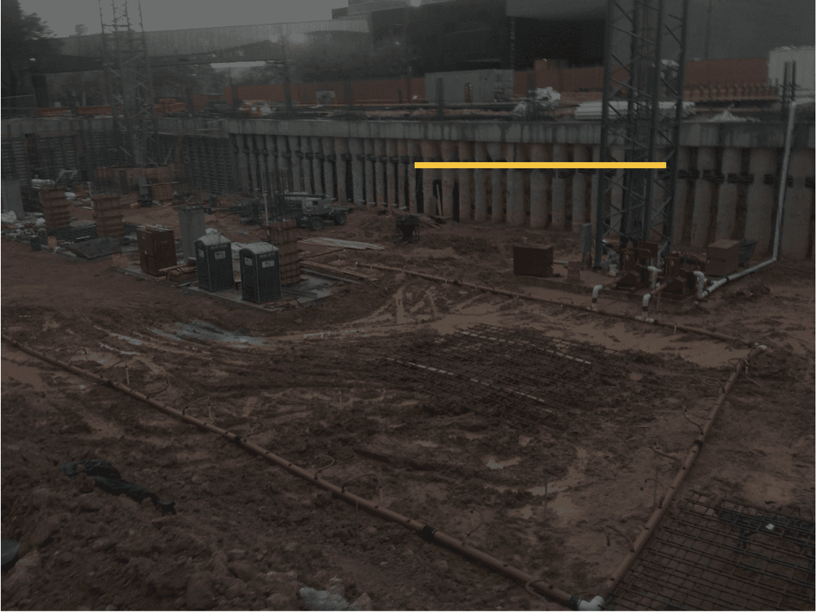
03 / EVACUATION & CASUALTY TRANSFER
Design rescue routes.
Do not improvise.
GREEN: CASUALTY
STAGING POINT
Command, first aid and
external-response
A lower-basement casualty can only be evacuated safely through a route that is inspected, protected from SIMOPS and physically capable of the planned transfer method.
handover.
PROVIDE PROTECTED ROUTES
01
Maintain two independently usable routes where reasonably practicable, leading to the safe transfer/ambulance interface outside lift and hose influence zones.
WALK THE FULL CASUALTY PATH
02
Test the stretcher route, turning points, stairs/ramps, gates, lighting and staging point on the actual workface before high-risk SIMOPS begins.
KEEP THE ROUTE STERILE
PROTECTED EVACUATION /
03
No storage, rebar bundles, pump hoses, temporary cables, lifting gear, plant or worker breaks may obstruct emergency movement.
CASUALTY TRANSFER ROUTE
HOLD THE ROUTE DURING RESCUE
04
A route marshal freezes deliveries, lifts and conflicting movement until the casualty is transferred and the workface is formally handed back.
RED: NO IMPROVISED ACCESS
PROHIBITED: do not use crane hooks, walings, struts, formwork, rebar cages or improvised access as a casualty-rescue method.
Control the water, pressure, electrical
and structural hazards before rescue
entry.

Slide 5

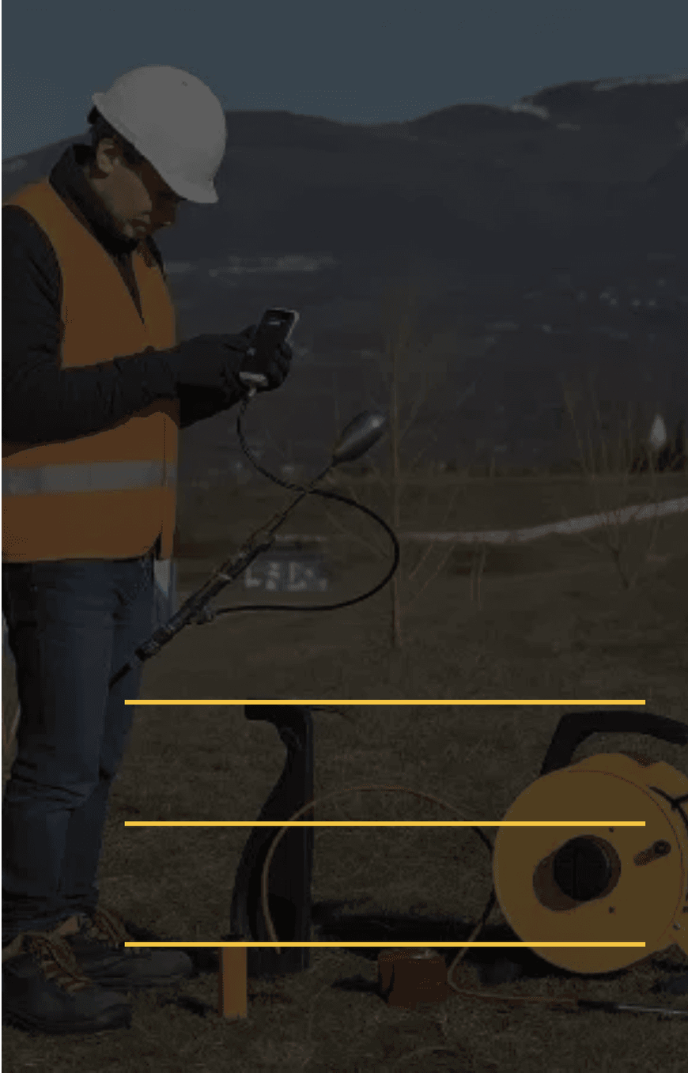
04 / PHYSICAL WORKFACE CONTROL
Emergency zones must be visible.
Mark the actual floor, not only the drawing. Every plant move, pour advance, lift-route change or water event requires the SIMOPS plan and emergency zones to be revalidated.
LOWER-BASEMENT WORKFACE — DAILY SIMOPS PLAN
RED · LIFT / FALL ZONE
AMBER · HOSE / POUR ZONE
BLACK
EXCLUDE
PROTECT THE BLUE ROUTE
GREEN · COMMAND / CASUALTY STAGE
Keep it outside lift/fall and hose-whip zones, lit, marked and clear for the rescue party.
BLUE · PROTECTED EVACUATION ROUTE
→
CONTROL THE RED ZONE
RED: clear before any load enters · AMBER: control pressure/whip risk · BLUE: no storage or plant · GREEN: responders only · BLACK: authorised specialist entry only
No structural work, rescue staging or normal access beneath a suspended load.
USE LIVE INFORMATION
Monitoring, water status and visual inspection can change the black-exclusion boundary immediately.
ZONES ARE A LIVE CONTROL: DRAW THEM, BARRICADE THEM, BRIEF THEM AND CHANGE THEM ONLY THROUGH COORDINATION.
05 / 12

Slide 6

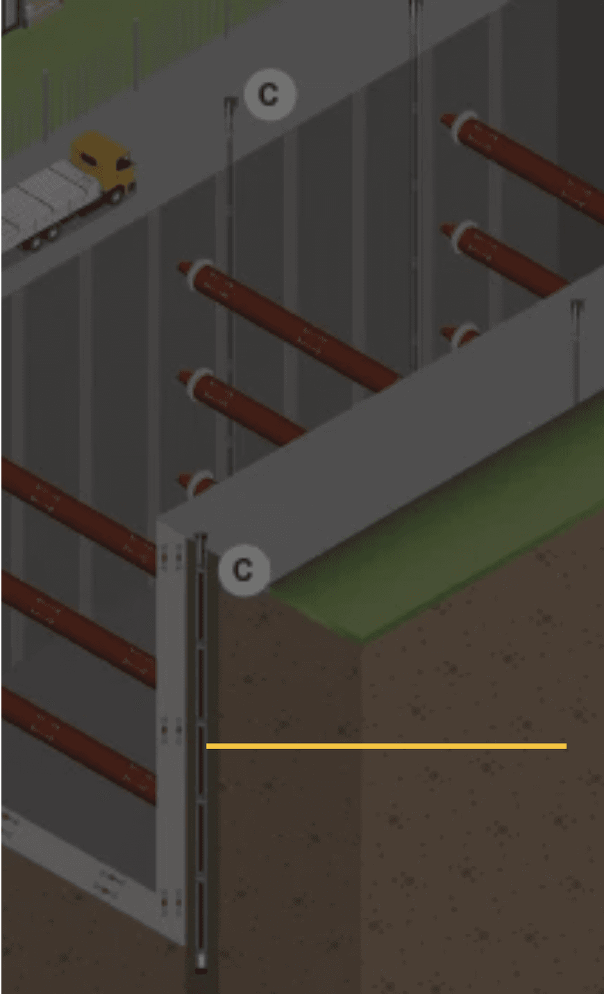
05 / EMERGENCY COMMAND
POSITIVE STATUS REPORTING
Every supervisor has an emergency role.
One Incident Controller commands the workface. Specialist supervisors make their own hazards safe, then report positively that the rescue route is clear.
INCIDENT CONTROLLER
Orders ALL STOP, assigns command, confirms escalation and prevents restart until the formal recovery gate closes.
01
LIFTING SUPERVISOR
Stops crane activity; lands or secures the load only under the lift-plan contingency; protects the lift/fall zone.
02
CONCRETE SUPERVISOR
Stops pumping, controls line pressure and hose-whip exposure, and clears the concrete route from evacuation access.
03
DEWATERING / ELECTRICAL
Maintains duty/standby pumping; controls water and electrical hazards; no isolation removes the last effective pump.
04
RESCUE / HSE LEAD
Assesses entry safety, dispatches trained first aid/rescue resources, controls casualty transfer and records incident status.
05
SECURITY / EXTERNAL INTERFACE
Keeps gate and ambulance access open, meets responders and guides them to the correct basement access and staging point.
ONE COMMAND.
No supervisor may restart their own activity after an incident: the Incident Controller releases the workface only after permits, evidence and SIMOPS controls are revalidated.
MULTIPLE HAZARD
CONTROLS.
Each supervisor confirms their own hazard is
controlled before rescue entry or restart.
06 / 12

Slide 7

06 / PRE-START EMERGENCY GATE
Verify six conditions before the shift begins.
Rescue readiness is a release gate.
Each condition applies to the named basement level, workface and planned lift/pour sequence—not a generic site arrangement.
SIMOPS cannot start because the lift plan and pour plan exist. The actual lower-basement workface must be ready to evacuate and transfer an injured person safely.
Incident Controller, rescue lead and shift deputies are named; the radio/emergency channel has been tested.
01
COMMAND
02
PROTECTED ROUTE
Evacuation and stretcher-transfer route is clear, lit, marked and outside lift/fall and concrete-hose zones.
03
LIFT CONTINGENCY
Crane all-stop, load hold/landing contingency, exclusion zone and operator communication are briefed.
NO ROUTE, NO COMMAND, NO RESCUE RESOURCE OR NO WATER-CONTROL RESILIENCE = NO SIMOPS RELEASE.
04
CONCRETE CONTINGENCY
Pump shutdown, line-pressure control and hose-whip exclusion are available without blocking escape.
05
WATER / POWER
Duty and standby pumping, temporary power and electrical isolation arrangements preserve excavation stability.
CoP 29.0 requires foreseeable emergencies to be identified and appropriate procedures developed; emergency rescue and first-aid systems must be planned for excavation work.
06
EXTERNAL RESPONSE
Casualty staging, emergency contacts, security/gate guide and ambulance approach point are confirmed.
THE ROUTE MUST BE DRILLED, NOT ASSUMED.
Test the actual casualty-transfer route after material changes to access, crane position, formwork, pump line
or dewatering arrangement.
RELEASE EVIDENCE: ROUTE WALKDOWN · RESOURCE CHECK · COMMUNICATIONS TEST · SHIFT BRIEFING · DRILL RECORD
07 / 12

Slide 8

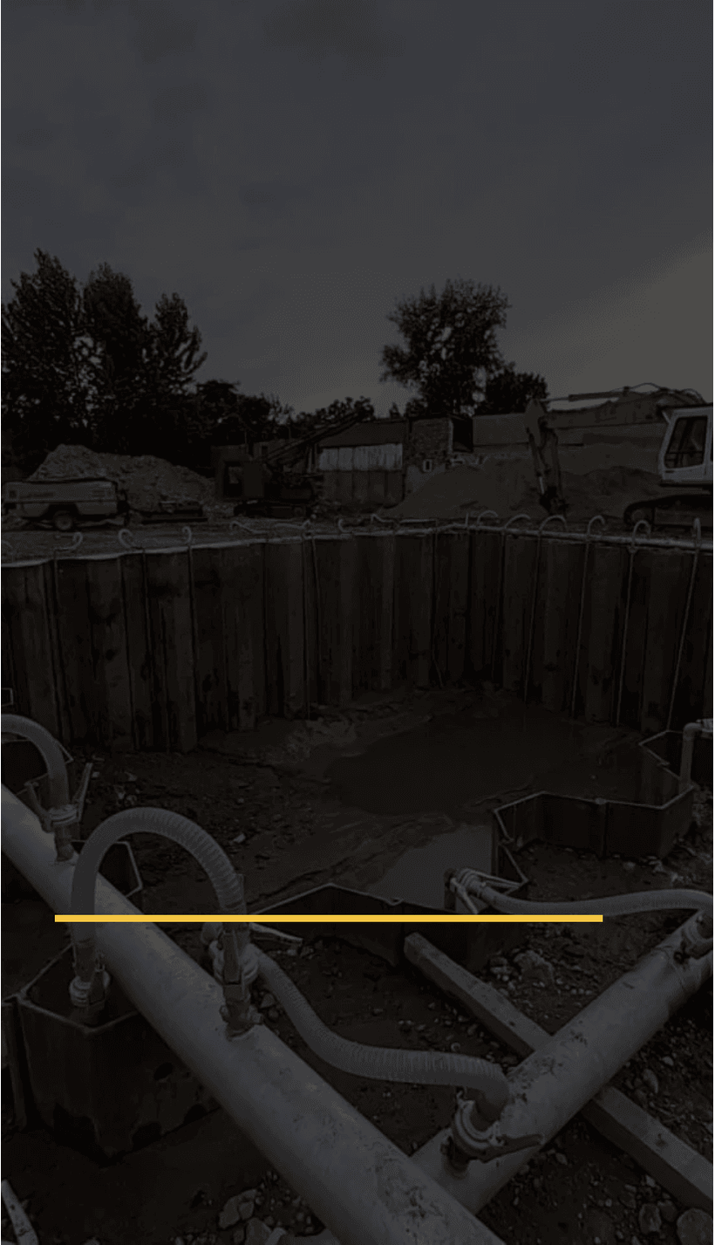
LIVE WORKFACE CONDITIONS
07 / CONCRETE-STRENGTH EVIDENCE
NDT informs—engineering decides.
A shoring-release decision requires the stage-specific structural criterion, traceable test evidence and the complete permanent load path. NDT is valuable—but it is not a stand-alone release certificate.
01
CURED CUBES
Normal production evidence against the approved stage-strength criterion; linked to the actual pour and test age.
02
MATURITY
Supports early-age decisions only where the project mixture has an approved strength–maturity relationship.
03
REBOUND / UPV
Indirect methods for mapping uniformity or anomalies; use only through an approved, project-specific correlation.
04
CORES
Direct in-situ evidence where uncertainty, variability or consequence requires further investigation.
05
FINAL DECISION
Structural engineer and temporary-works designer reconcile evidence, load path, water condition and monitoring before staged release.
TEST RESULTS ARE ONE PART OF THE SAFETY CASE
NO NDT-ONLY SUPPORT RELEASE
Confirm groundwater, dewatering resilience, support response and the approved load-transfer stage at the same time.
Rebound number or pulse velocity cannot, by itself, prove that the permanent structure can take the temporary load.
08 / 12

Slide 9

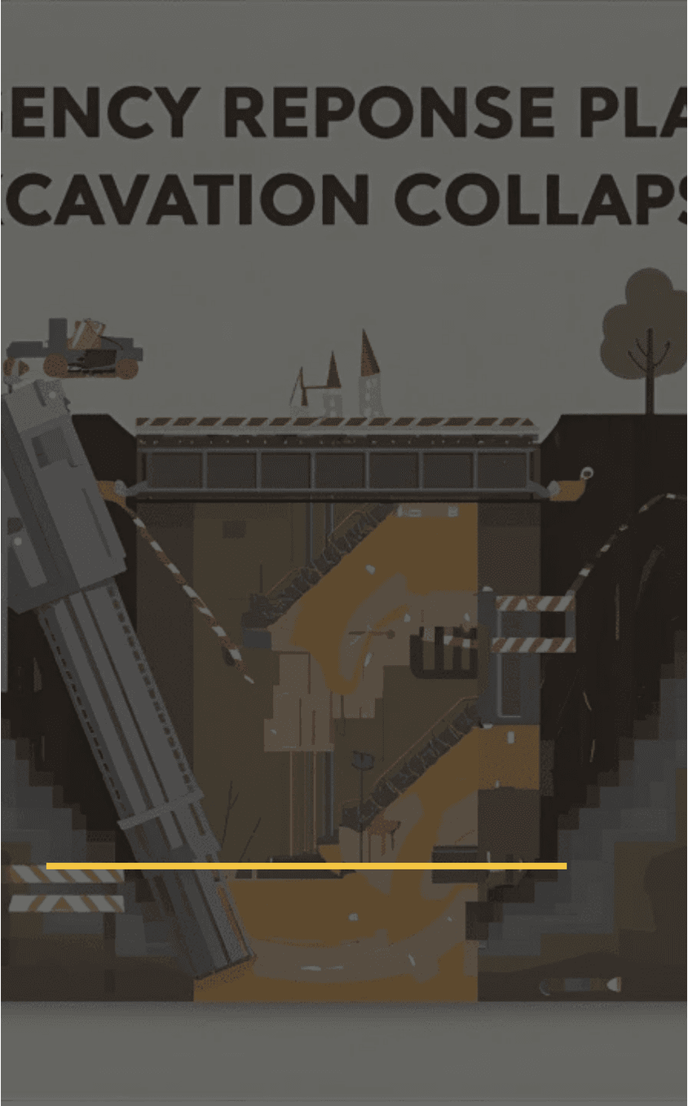
HIGH-CONSEQUENCE DECISION
08 / THIRD-PARTY EVIDENCE
Laboratory scope is evidence.
An ISO/IEC 17025 certificate only supports the decision when the laboratory’s current accredited scope covers the exact concrete test method and when its report is traceable to the member and release stage.
01
CURRENT ACCREDITATION
Confirm ISO/IEC 17025:2017 accreditation recognised by ENAS, EIAC or another authority/consultant-accepted body.
02
EXACT METHOD SCOPE
Check the scope schedule for the actual method: cube compression, maturity, rebound, UPV, penetration/pull-out or core testing.
03
COMPETENT EXECUTION
Verify trained technician, controlled equipment, calibration/verification record, field procedure and raw-data traceability.
04
REPORT LIMITATIONS
Indirect NDT report states its correlation and limitation; direct core report records location, sampling, repair and engineering context.
05
ENGINEERING ACCEPTANCE
Structural engineer and temporary-works designer reconcile evidence with the stage criterion, load path, water and monitoring condition.
LABORATORY REPORT + PROJECT-SPECIFIC INTERPRETATION + FORMAL STAGED RELEASE = defensible support-change decision
DATA DOES NOT RELEASE SUPPORT. ENGINEERS DO.
The accepted report is one evidence stream within the full temporary-works and permanent-load-transfer safety case.
NO-GO: generic accreditation, an out-of-scope method, an untraceable sample or an NDT-only conclusion does not authorise shoring release.
09 / 12

Slide 10

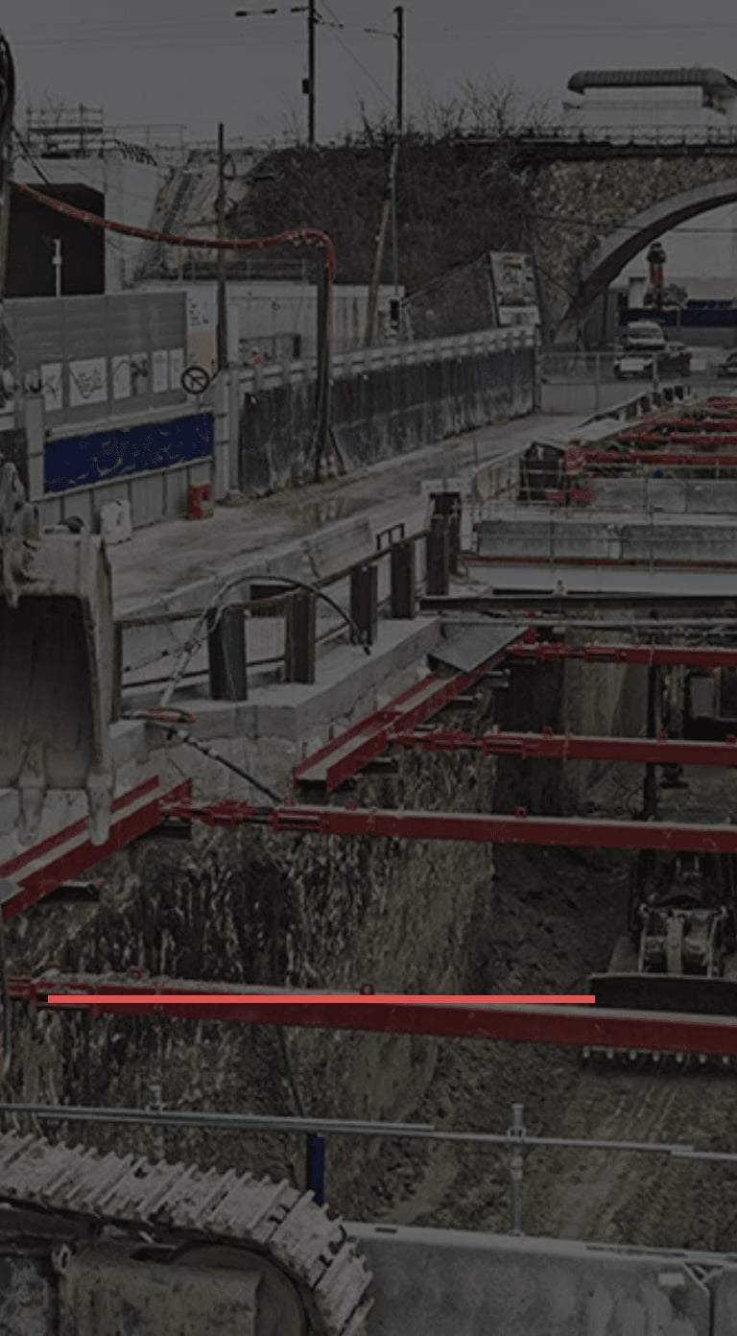
LIVE WORKFACE CONTROL
09 / PERMIT AND RELEASE CONTROL
The permit interface is live.
Lifting, formwork, excavation, dewatering, emergency rescue and concrete placement are linked controls. They must all be valid for the same workface, shift and sequence.
REF
INTERFACE
PRE-WORK ACCEPTANCE
DECISION
01
LIFT PLAN
Actual load, radius, route, crane position, weather, accessories and exclusion zone accepted.
VALID
02
FORMWORK RELEASE
Configuration, capacity, inspection, protected egress and crew briefing accepted.
VALID
03
EXCAVATION PTW
Shoring, monitoring, water condition, surcharge and permitted workface accepted.
VALID
04
DEWATERING / LOTO
Duty/standby pumping and electrical isolation preserve water-control resilience.
VALID
05
EMERGENCY RESCUE
Route, staging point, command, resources, communications and external interface verified.
VALID
06
CONCRETE POUR
Pump/hose control, formwork readiness, truck route and protected evacuation access accepted.
VALID
PERMITS ALIGN OR WORK
ONE HOLD OR EXPIRED RELEASE BLOCKS THE ASSOCIATED WORK.
STOPS.
Do not solve a permit conflict by changing the workface informally. Stop, assess the interface, amend the plan and formally
Each document must reflect the same load,
revalidate.
route, floor, excavation condition and emergency
arrangement.
10 / 12

Slide 11

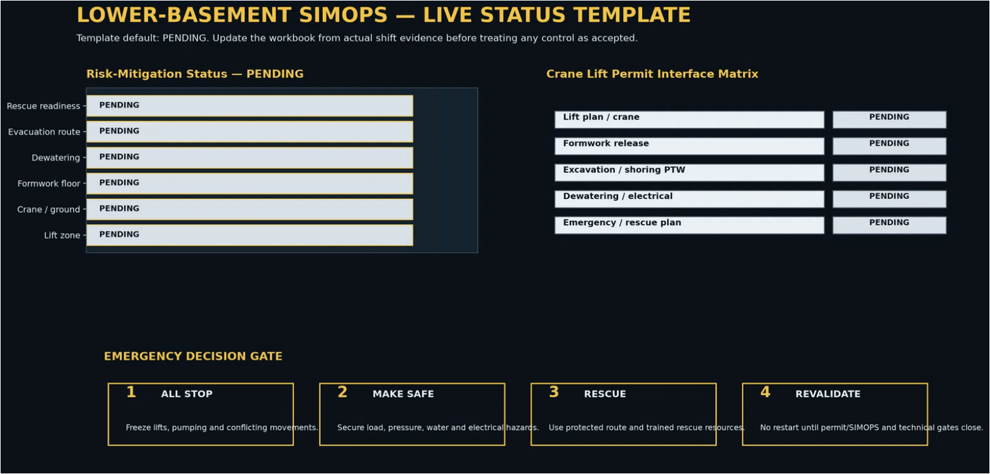
10 / MANAGEMENT VISIBILITY
A dashboard supports the decision. It does not replace it.
The dashboard makes holds visible.
Review live risk mitigation, crane-permit interfaces and emergency readiness together before the shift or high-risk lift proceeds.
The project manager uses one view to identify missing evidence, conflicting work and permit conditions before they create a workface exposure.
1 · PENDING MEANS UNASSESSED
No default status is an acceptance. The named supervisor must provide current evidence.
2 · ONE HOLD BLOCKS WORK
A HOLD, EXPIRED or RED item stops the associated lift, pour, formwork or support activity until revalidated.
3 · READ THE INTERFACES TOGETHER
Lift plan, formwork release, excavation PTW, dewatering/LOTO and rescue readiness must align for the same workface.
TEMPLATE STATE ONLY: the image intentionally shows PENDING status. It becomes a live management control only after the team enters actual shift inspections, permits, monitoring results and route-walkdown evidence in the linked workbook.
LIVE EVIDENCE INPUTS: SIMOPS CHECKLIST · PERMIT MATRIX · EMERGENCY ROUTE CHECK · MONITORING / DEWATERING STATUS
11 / 12

Slide 12

CLOSING STANDARD
No evidence
gap.
CONTROLLED LOWER-BASEMENT WORKFACE
×
Safe lower-basement SIMOPS depends on an evidence-led decision at every shift, lift, pour, support change and emergency restart.
CONTROLLED LIFT / FALL ZONE
NO WORK BENEATH A SUSPENDED LOAD. NO NDT-ONLY SHORING RELEASE. NO UNPLANNED RESCUE MEANS. NO RESTART WITHOUT REVALIDATION.
EVIDENCE → RELEASE
PROTECTED ROUTE
MANAGEMENT STANDARD: COMMAND THE WORKFACE, PROTECT THE ROUTE, VERIFY THE EVIDENCE, RELEASE ONLY WHEN SAFE.
12 / 12

